Slide 1
Module 2: Mandated Tasks of United Nations Peacekeeping Operations
Lesson
2.1
Mandated Tasks

Slide 2
Relevance
Peacekeeping personnel must be familiar:
Shared tasks
All contribute
UN Core Pre-Deployment Training Materials 2017

Slide 3
Learning Outcomes
Learners will:
Identify four categories of mandated tasks
List examples of mandated tasks which are the core business of UN PKOs
Describe two critical areas where UN PKOs play a limited “support” role
List four humanitarian principles
UN Core Pre-Deployment Training Materials 2017

Slide 4
Lesson Overview
Overview of Mandated Tasks
Supervision or Monitoring of the Ceasefire Agreement
Provision of a Secure & Stable Environment
Facilitating the Political Process
Facilitating the Delivery of Humanitarian Assistance
Supporting Poverty Reduction & Economic Development
UN Core Pre-Deployment Training Materials 2017

Slide 5
Learning Activity
2.1.1
Mandated Tasks
Instructions:
Match images with tasks, definitions and challenges addressed
Discuss impact of the challenges on civilians
Identify peace and security, humanitarian and development tasks
Time: 10 minutes
Group work: 5-7 minutes
Discussion: 3 minutes
UN Core Pre-Deployment Training Materials 2017

Slide 6
1. Overview of Mandated Tasks
The range of mandated tasks may be categorized in the following way:
Core business
Support roles
Peacebuilding activities
Cross-cutting thematic tasks
UN Core Pre-Deployment Training Materials 2017

Slide 7
Learning Activity
2.1.2
Putting Tasks into Categories
Instructions:
Label tasks as core business, supporting role, peacebuilding activity and cross-cutting themes
Give reasons
Time: 5 minutes
Brainstorming: 3 minutes
Discussion: 2 minutes
UN Core Pre-Deployment Training Materials 2017

Slide 8
The Core Business
Supervision or monitoring of the ceasefire agreement
Provision of a secure and stable environment
Facilitating the political process
UN Core Pre-Deployment Training Materials 2017

Slide 9
Peacebuilding Activities
Mine action
Disarmament, demobilization and reintegration (DDR) of ex-combatants
Security sector reform (SSR)
Rule of law (ROL)-related activities
Electoral assistance
Support to the restoration and extension of State authority
UN Core Pre-Deployment Training Materials 2017

Slide 10
Support Roles
Facilitating the delivery of humanitarian assistance
Cooperating and coordinating with mission partners to support poverty reduction and economic development
UN Core Pre-Deployment Training Materials 2017

Slide 11
Cross-Cutting Thematic Tasks
Human rights
Protection of civilians (POC)
Conflict-related sexual violence (CRSV)
Child protection
Women, Peace and Security (WPS)
UN Core Pre-Deployment Training Materials 2017

Slide 12
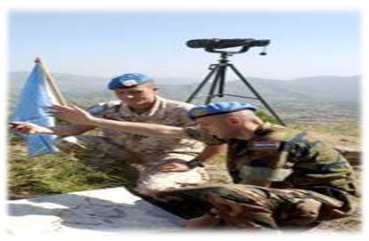
2. Supervision or Monitoring of the
Ceasefire Agreement
Ceasefire agreement: refers to a temporary stoppage of war or any armed conflict for an agreed-upon timeframe or within a limited area
Monitoring ceasefire agreements:
involves actions to gather
information on compliance with
an agreement
UNPKOs monitor to reassure that parties will not exploit ceasefires to gain military advantage
Core business
UN Core Pre-Deployment Training Materials 2017

Slide 13
3. Provision of a Secure & Stable Environment
A secure environment is generally a pre-condition for moving ahead on several elements of peace agreements
UNPKOs help fill the security/public order vacuum, and as a result play a critical role in securing the peace process and creating a safe environment for humanitarian and development actors
Primary role of the military
component
Core business
UN Core Pre-Deployment Training Materials 2017

Slide 14
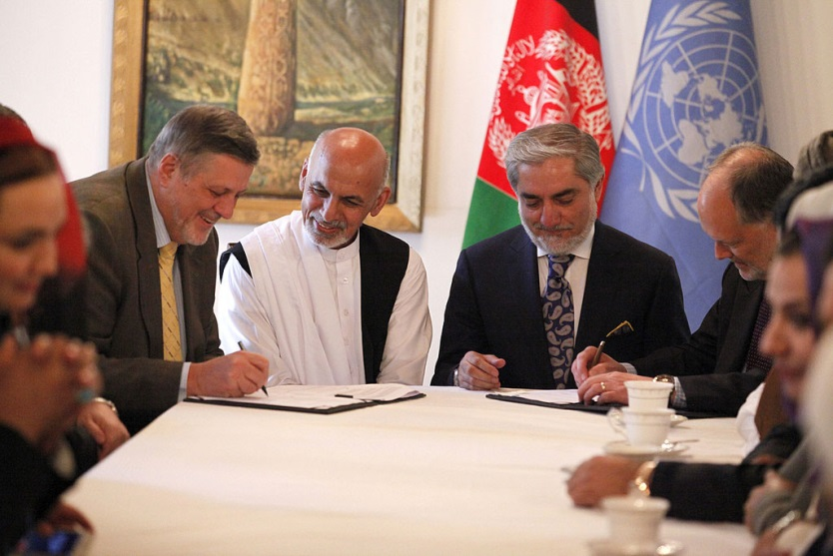
4. Facilitating the Political Process
Political process: steps to end conflict, maintain peace – involves peace negotiations and peace agreements
UNPKOs facilitate the political process by promoting dialogue and reconciliation, and supporting the establishment of legitimate and effective institutions of governance
Important for a lasting settlement or longer-term political solutions
Core business
UN Core Pre-Deployment Training Materials 2017

Slide 15
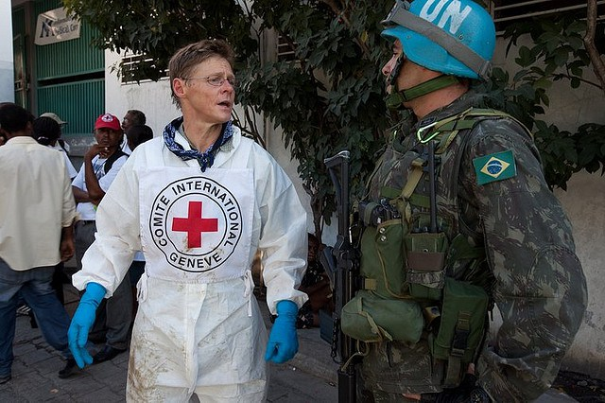
5. Facilitating the Delivery of
Humanitarian Assistance
Humanitarian assistance: aid and action designed to save lives, alleviate suffering, and maintain and protect human dignity during and in the aftermath of man-made crises and natural disasters
Includes basic supplies of drinking water, food, shelter, medical care, protection and assistance to refugees and
IDPs
UNPKOs facilitate delivery
Support role
UN Core Pre-Deployment Training Materials 2017

Slide 16
Responsibilities
Host Country
International and National Humanitarian Actors
e.g. UN agencies, ICRC, NGOs
Has Capacity
If No
If Yes
UNPKO assists by providing a secure environment
Initiates, coordinates and delivers humanitarian assistance
UN Core Pre-Deployment Training Materials 2017

Slide 17
“Humanitarian Space”
An environment where receiving humanitarian assistance is independent of military and political action
Ensures safety and accomplishment of humanitarian actions and personnel
Four humanitarian principles: humanity, neutrality, impartiality and independence
Complementary concepts for civil-military coordination: UN-CIMIC (UNPKO) and UN-CMCoord (OCHA)
UN Core Pre-Deployment Training Materials 2017

Slide 18
Learning Activity
2.1.3
“Humanitarian Space”
Instructions:
You are a humanitarian worker
Consider the photo and scenario
How can the mission help with the challenges?
Discuss importance of “humanity”, “neutrality”, “impartiality” and “independence”
Time: 15 minutes
Group work: 5-7 minutes
Discussion: 5-7 minutes
UN Core Pre-Deployment Training Materials 2017

Slide 19
6. Supporting Poverty Reduction &
Economic Development
Poverty reduction: ‘pro-poor’ policies and policies to stimulate economic growth, raise incomes and indirectly reduce poverty
Poverty eradication is important for lasting peace and sustainable development
UNPKOs cooperate, coordinate with partners
Support role
UN Core Pre-Deployment Training Materials 2017

Slide 20
Summary of Key Messages
Mandated tasks – core business, peacebuilding activities, supporting roles, cross-cutting thematic tasks
Core business – monitor cease-fire, provide secure environment, facilitate political process
Supporting roles – facilitate delivery of humanitarian assistance, coordinate mission partners in development
Humanitarian principles – humanity, neutrality, impartiality, independence
UN Core Pre-Deployment Training Materials 2017

Slide 21
Questions
UN Core Pre-Deployment Training Materials 2017

Slide 22
Learning Activity
Learning Evaluation
UN Core Pre-Deployment Training Materials 2017

